Slide 1
Prime Numbers
And the principles of recursion

Slide 2
Divide and Conquer explanation
The divide and conquer method is a method where all work is split into different branches. One branch does something while the other branches are also working. Once all the different tasks are completed or at least simplified as much as possible, all the different work that each branch did is combined into one single result.
This method uses recursion in the way that it divides the work – into smaller groups that are still part of the overall problem.

Slide 3
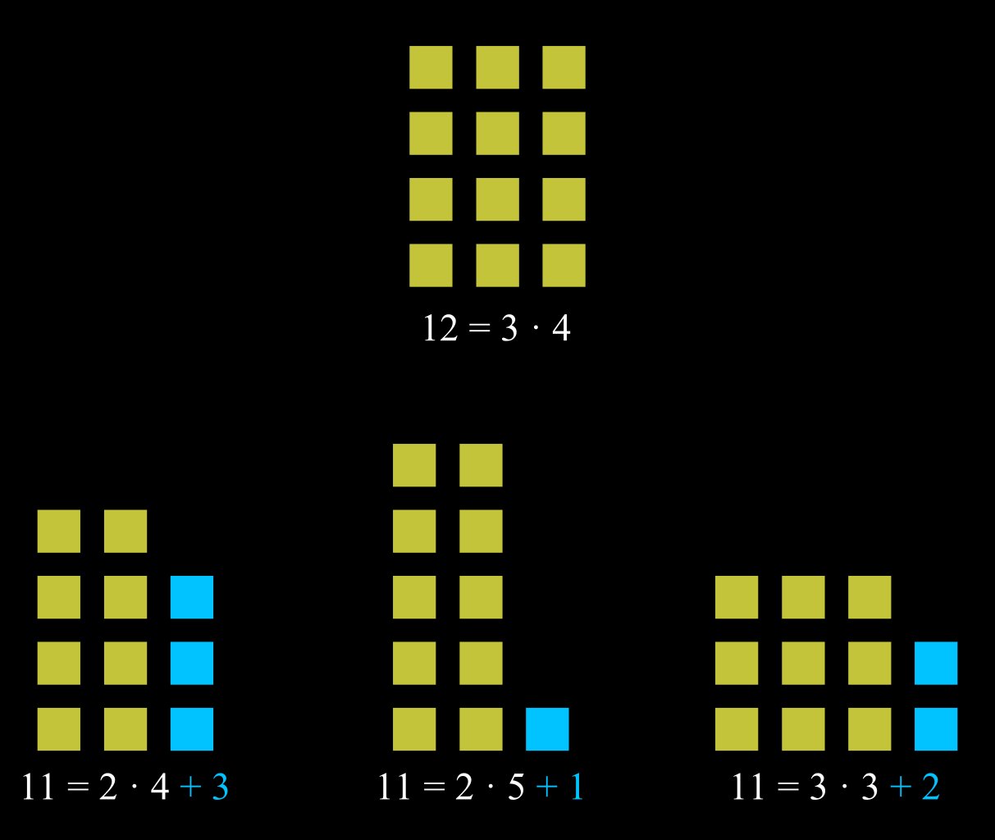
Example regarding prime numbers
The problem – if 12, 11, etc. are prime numbers – is solved here by dividing the number into smaller groups to see if a remainder is found

Slide 4
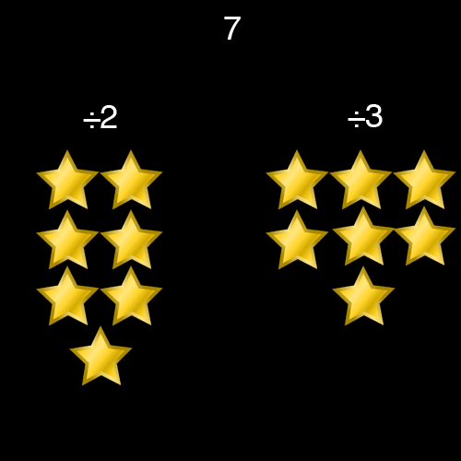
Another example I created

